Slide 1
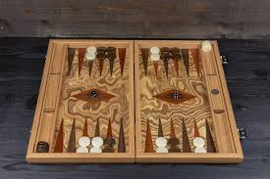
Backgammon AI
Project Context:
Problem: Using AI winning most games in backgammon
Who will care: Backgammon players
Data needs: used by evaluating all the moves possible with respect to each other.
Methods: Search min-max
Evaluation: after more than a month spend of building this project, the code does not run a game all the way. The moves the code does run, are strategic and are win oriented.
Trust Issue: is the move actually the best move?

Slide 2
Backgammon AI
Achivments:
Status: implemented the min max search game mode into the code, but it fails to run a full game.
Challenges I faced:
Spent weeks on how to figure out how to correctly search for the best move
Spent weeks on how to tie everything together
The game code I got from online was missing a lot of functionality to make the min max search game mode work

Slide 3
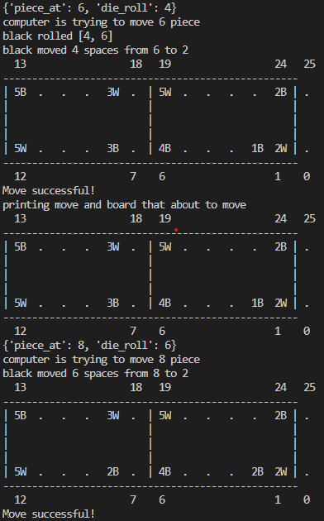
Backgammon AI
compare:
Tried to compare the min max search game mode with the other game modes. The mode plays with good strategy but running a big number of games to get the win percentage is not possible due to some errors in the code.
Code demo:
As you can see here, the computer made a smart move [4,6]. The game mode compared all the moves possible and determined that make this move would give the max utility. This move blocks the opponent to hit him and continue forward, thus lowering the min score

